Slide 2
GO BIG

Slide 3
OR GO HOME

Slide 4
OR CHANGE
PEOPLE'S LIVES

Slide 5
adiBalance
adidas hackathons
grand final 2018
iLike Classic®
Anastas Ruskov
Kalin Pezhgorski
Lyubomir Cholakov
Vesselin Pezhgorski

Slide 6
.balance.(early)Morning
Uuurgh
Back to the real world
It’s not so bad….

Slide 7
.balance.demo

Slide 8
.balance.who
Not yet into sport
Want to change something
Want to improve

Slide 9
.balance.why
Win the morning,
Win the day!

Slide 10
.balance.why
Win the morning -> win the day
Baby steps -> make it a habit, routine
Human = complex system

Slide 11
.balance.why.3pillars
MIND
SOUL
BODY

Slide 12
.balance.why.body
BODY
External strength -> internal strength
Self confidence
-----------------------------------------------------------------------
Squats, stretches, push ups, nutrition…

Slide 13
.balance.why.mind
MIND
Knowledge is power
Free thinking individual
-----------------------------------------------------------------------
Learn why, how, when, what…

Slide 14
.balance.why.soul
SOUL
Authentic when in tune with inner self
Who you are
-----------------------------------------------------------------------
Yoga, meditation, self reflection, gratitude…

Slide 15
.balance.how
AR.
SOCIAL INTERACTION

Slide 16

.balance.how
We care for others
Guiding spirit animal
Social networking
Friend
Coach
Motivator
Incentive

Slide 17
.balance.how.socialNetworking
High levels -> mentoring
Connection suggestions
Organizing events

Slide 18
.balance.how.tech
IBM Watson (AI assistant, speech to text, text to speech)
Unity -> Vuforia (GPS, groundplane(AR Core))
C#

Slide 19
.balance.revenue
SHARED
PHILOSOPHY

Slide 20
.balance.revenue.standard
Classic
access to special offers or exclusuive events
Grow your own product (uniqueification)

Slide 21
.balance.revenue.propper
Non classic – shared philosophy
Engage with a new market (indirectly)
Identify with the adidas philosophy (through sport -> change lives)
Become part of the adidas experience long term

Slide 22
BECOME THE BEST VERSION
OF YOURSELF

Slide 23
//TODO
Networking
Improved AI
Mixed tracking (GPS + Ground + Human recognition)
Advanced customization
Collaboration with existing platforms

Slide 24
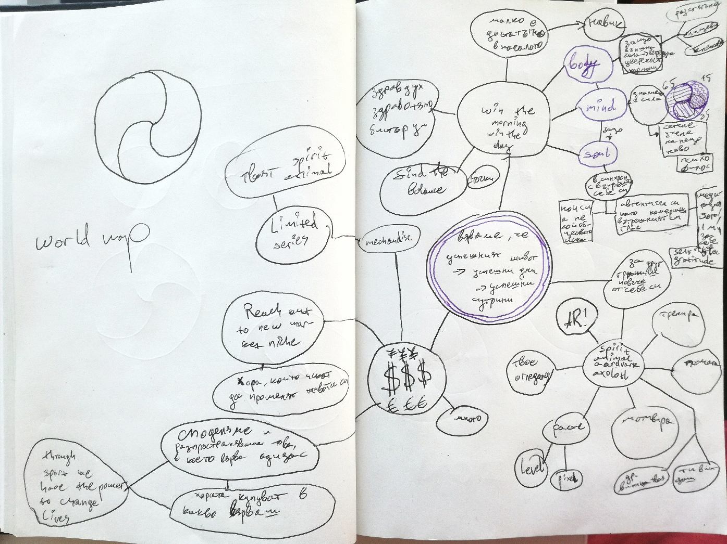
.balance.in2words
Whollistic approach
Long term engagement
New market
Uptrending tech

Slide 25
BECOME THE BEST VERSION
OF YOURSELF

Slide 27
Thank you
for your attention!

Slide 28
Q&A

